Slide 1
Spatial Objects in R Using r as a GIS software
Alejandro Ordonez
Assistant Professor - Department of Bioscience
Section for Ecoinformatics & Biodiversity
Center for Biodiversity Dynamics in a Changing World (BIOCHANGE)

Slide 2
Spatial Objects in R What we will talk about today
R as a GIS tool.
Spatial object classes – Point, lines, polygons and grids.
Plotting spatial objects – Plotting Spatial* objects.
Spatial Raster’s in R – From features to gridded information.
Operations with Rasters – Map algebra with Raster* objects.
Linking to other GIS Software – How to load/save info coming from other programs.

Slide 3
Any questions?
Ready to begin?

Slide 4
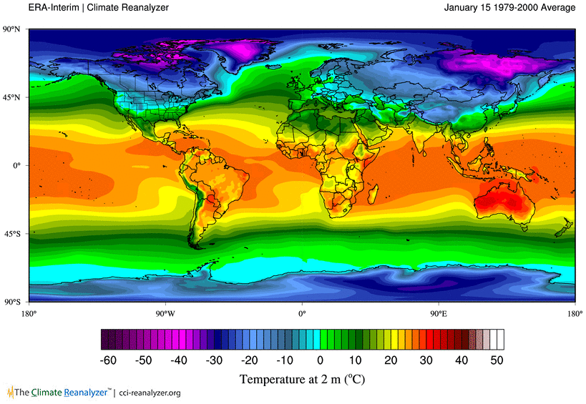
We live in a data-rich world… and most of this information is spatiotemporal in nature.

Slide 5
What is spatial information?
Mathematical construct for representing objects or surfaces in the physical world as data.
For this, we need to define:
The Physical location of objects
Where they are in Earth
Linked to a coordinate/projection system.
The relation between objects.
How the different elements of the object are placed relative to each other.
The attributes of the objects.
The data to be represented

Slide 6
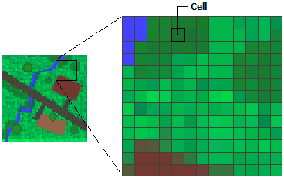
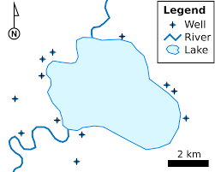
What is spatial information?
Data model types:
Spatial Raster models:
represents the geography of cell matrices that store numeric values.
Spatial Vector models:
represents geography as collections of points, lines, or polygons.
Figures ESRSI

Slide 7
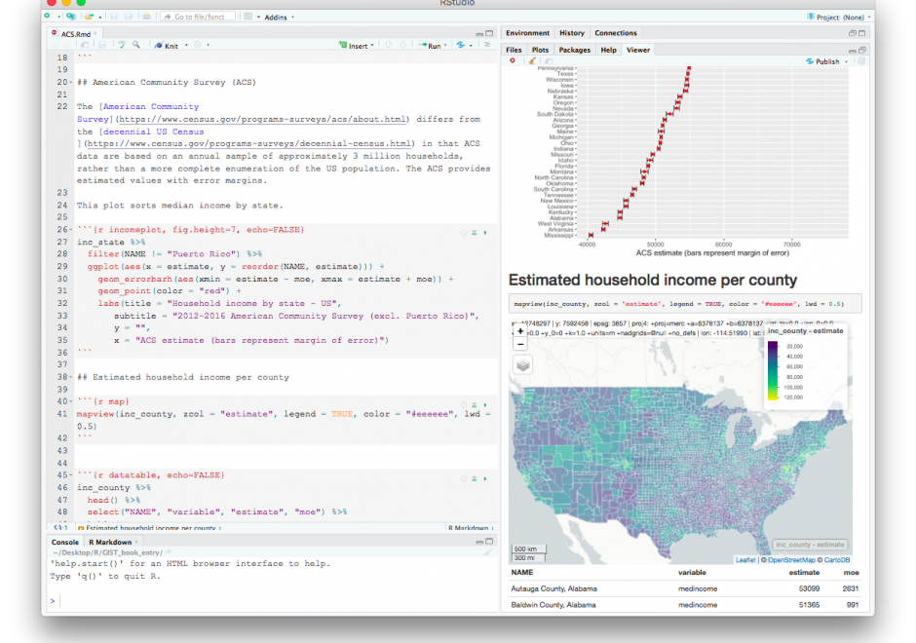
spatial information Why R?
STATE OF THE ART
Large availability of basic and of advanced geospatial analytical techniques.
VISUALIZATION
All types of visualizations are easily produced.
INTEGRATION
ALL the research pathway is in one single Open-access environment.
REPRODUCIBILITY
What that means is that it is easy to replicate what you have done!

Slide 8
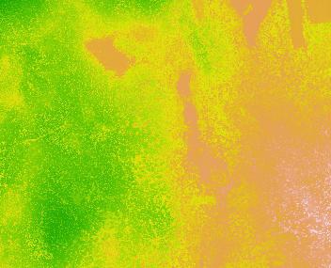
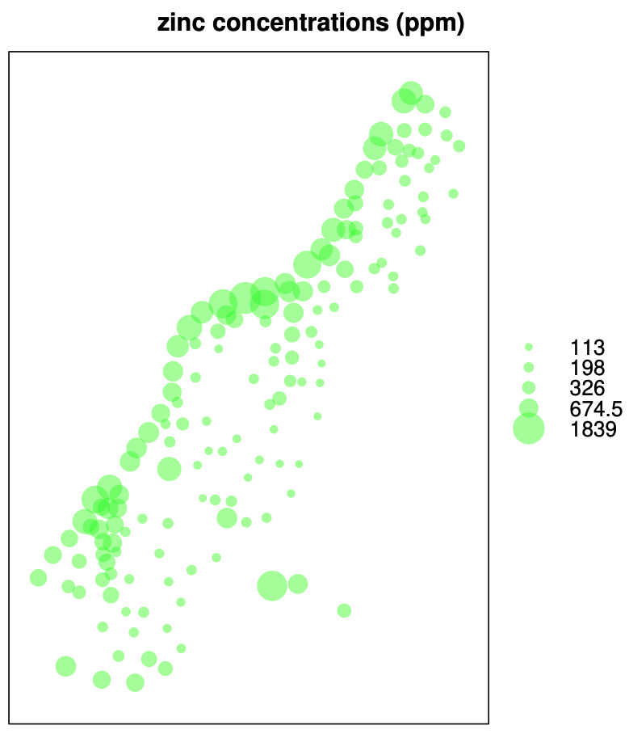
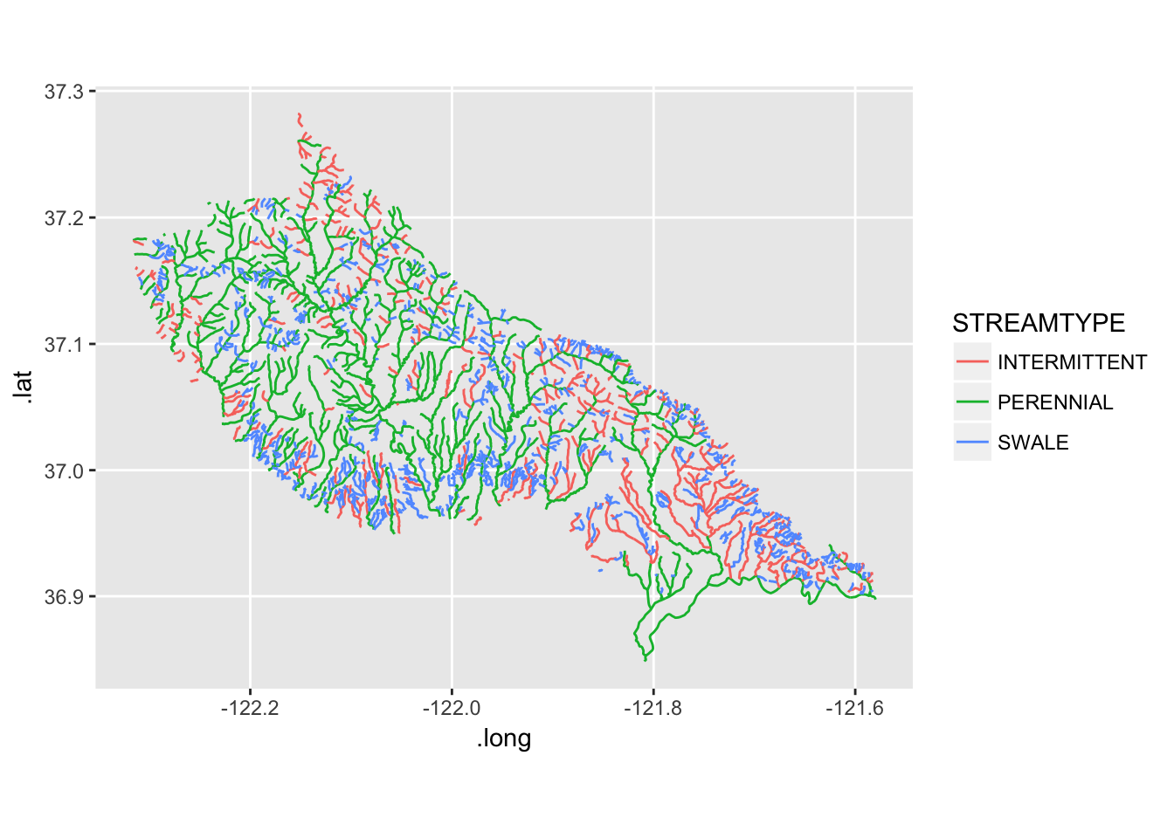
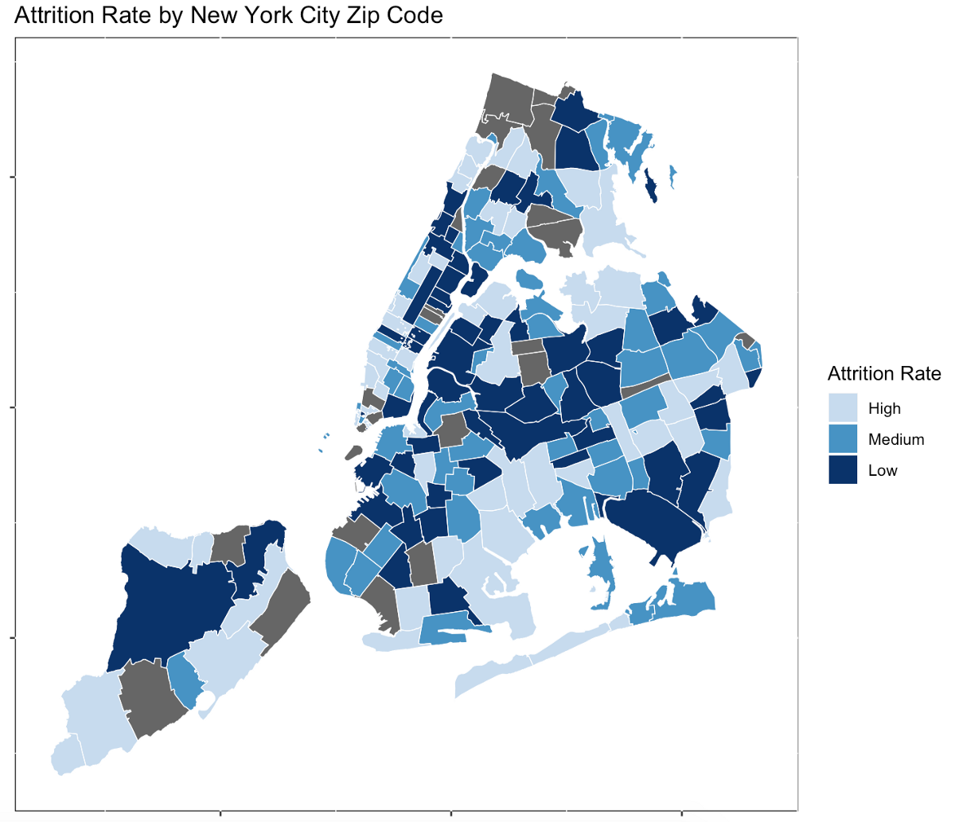
Spatial Objects in R
Raster
Vector
SpatialPointsDataFrame
Layer
SpatialLinesDataFrame
Stack
or
Brick
SpatialPolygonsDataFrame

Slide 9
Spatial Objects in R
Raster
Vector
SpatialPointsDataFrame
Layer
SpatialLinesDataFrame
Stack
or
Brick
SpatialPolygonsDataFrame

Slide 10
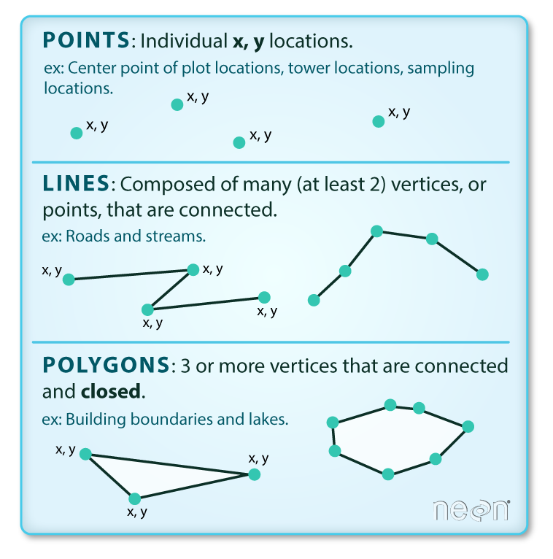
Spatial*databases Objects in R
Geometry
Data
Layer
ID | Class | Type | Size
1 | Forest | Conifer | 55
2 | Forest | Evergreen | 40
3 | Herbaceous | Grassland | 10
4 | Herbaceous | Pasture | 20
Stack
or
Brick

Slide 11
What is in the “Geometry” part?
Bounding box
Defines the limits of the “Physical” location of objects.
Coordinate system
Establishes the framework used to define the location of objects on the surface of the Earth.
Determines observation locations or the corners/intersections of geometric shapes (lines polygons)
Vertex

Slide 12
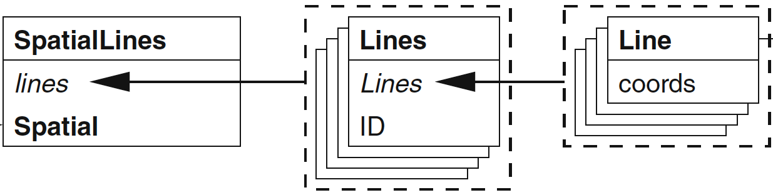
Spatial lines are combinations of line objects
Matrix of “vertexes”
Defining turning points
Defines the bbox and projection
A list of Line objects

Slide 13
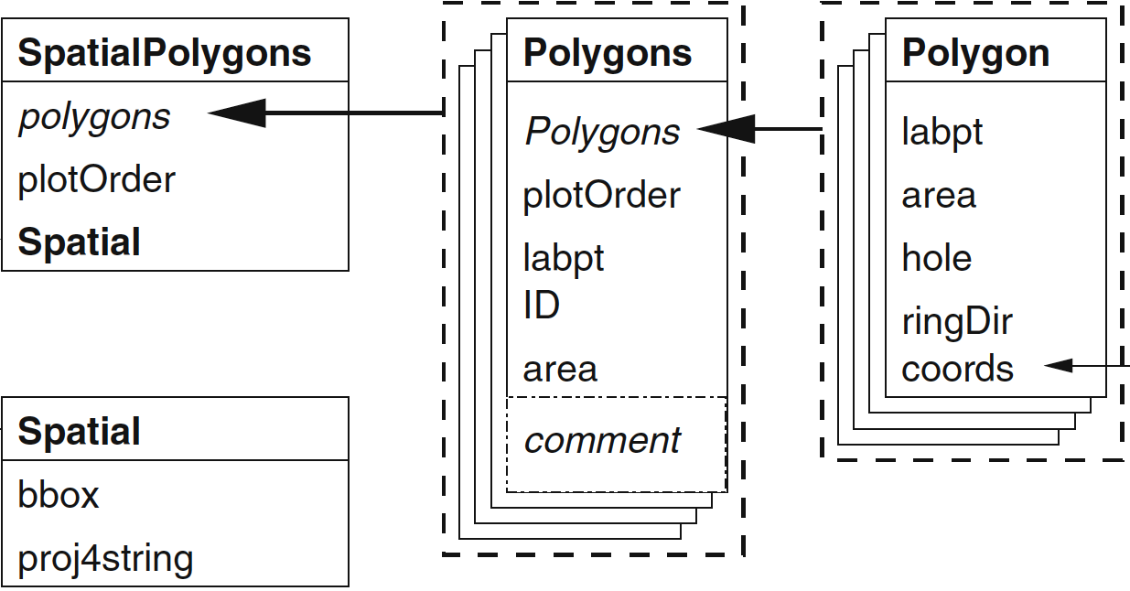
Spatial Polygons are combinations of Polygon objects
Defines the “geometry” of each Polygon object
Matrix of “vertexes”
A slot where a list of Polygon objects is stored

Slide 14

Projections in R CRS class objects
flat. It contains a GCS, but it converts that GCS into a flat surface, using math (the projection algorithm) and other parameters. Its units are linear, most commonly in meters.
CRS objects are a character string in the PROJ-format [formerly PROJ.4] that describes the coordinate systems and transformations.
Geographical reference system
(GRS)
Projected reference system
(PRS)
A spherical representation of the Earth.
Reference framework that defines the locations of features on a model of the earth. It’s shaped like a globe—spherical.
Its units are angular, usually degrees.
A flat representation of the Earth.
It contains a GRS, but it converts into a flat surface, using math (the projection algorithm) and other parameters.
Its units are linear, most commonly in meters.
+proj=laea

Slide 15
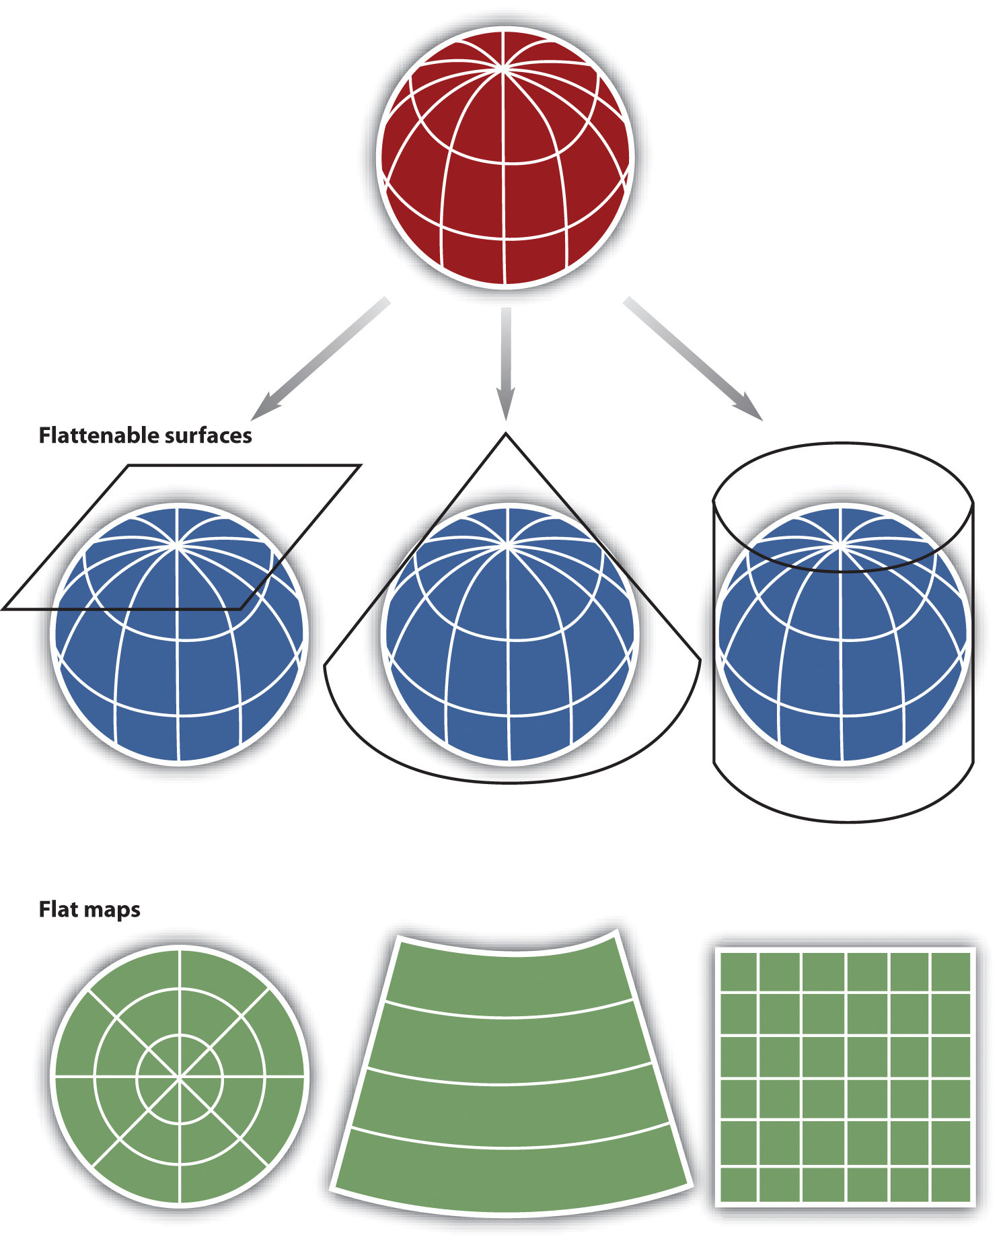
Geographic coordinate systems: coordinate systems that span the entire globe (e.g. latitude / longitude).
Projections
Projected coordinate systems:
coordinate systems that are localized to minimize visual distortion in a particular region.
Planar
Conical
Cylindrical
Representations

Slide 16
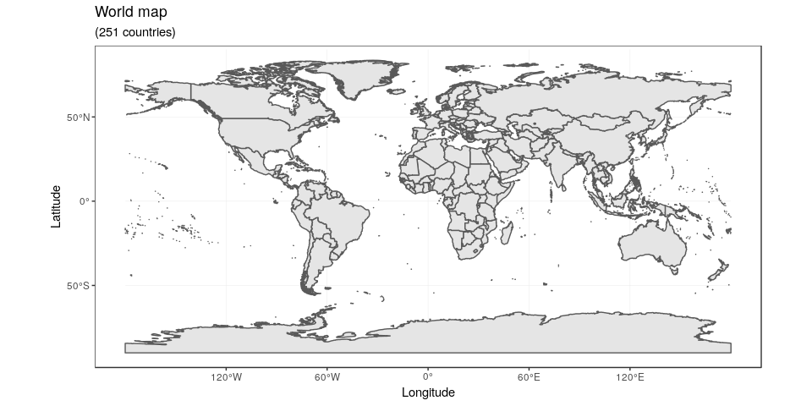
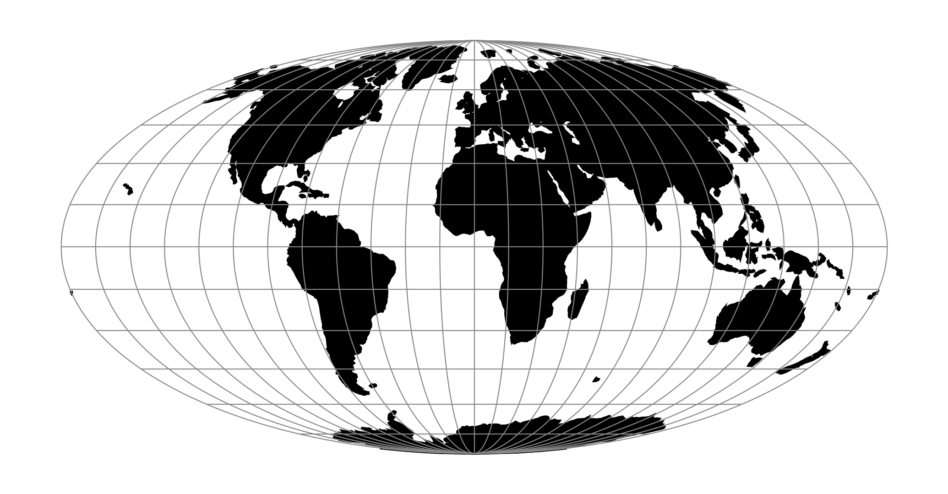
Projections in R CRS class objects
Geographical reference system.
Projected reference system.
+proj=laea
+proj= WGS84
+proj=moll

Slide 17
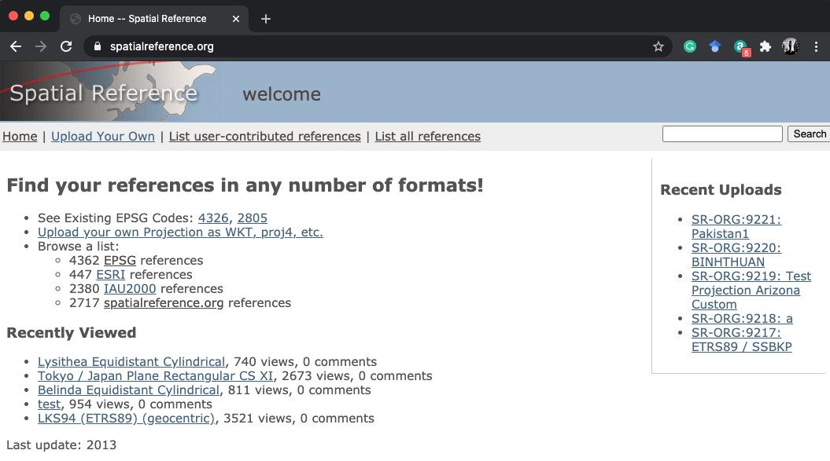
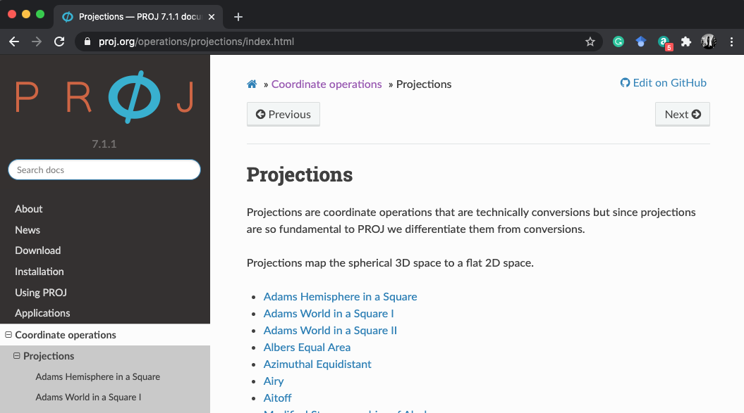
In both these sites you can get the PROJ strings for a defined Projection

Slide 18
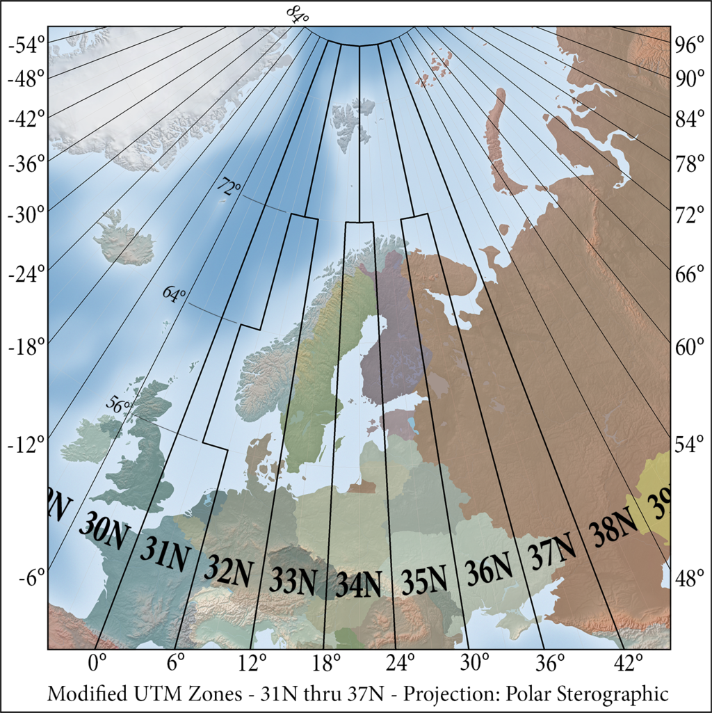
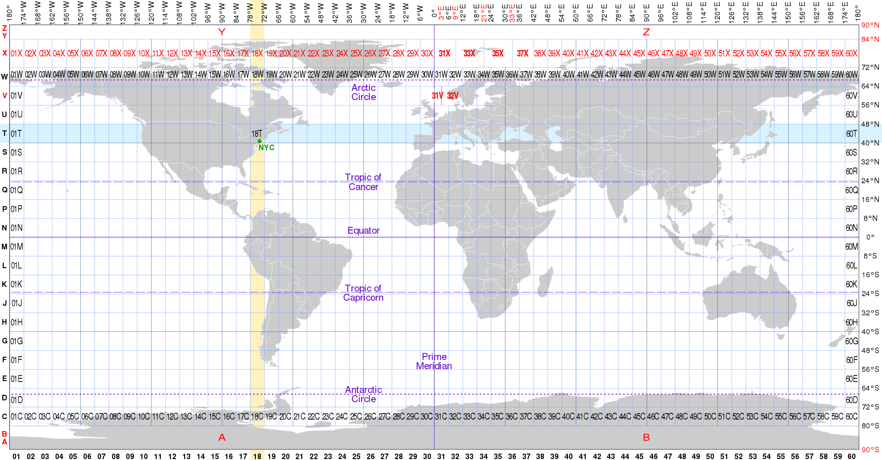
The UTM system
Universal Transverse Mercator (UTM) projection system is useful to define projections in smaller areas – like in a country
Provides a constant distance relationship anywhere on the map.
Denmark is between
UTM zones
32N and 33N
Denmark primary projection is UTM/ETRS89
Check https://sdfe.dk/media/2917583/001-etrs89-utm.pdf for the official projection of Denmark.
And https://epsg.io/25832 for the proj string

Slide 19
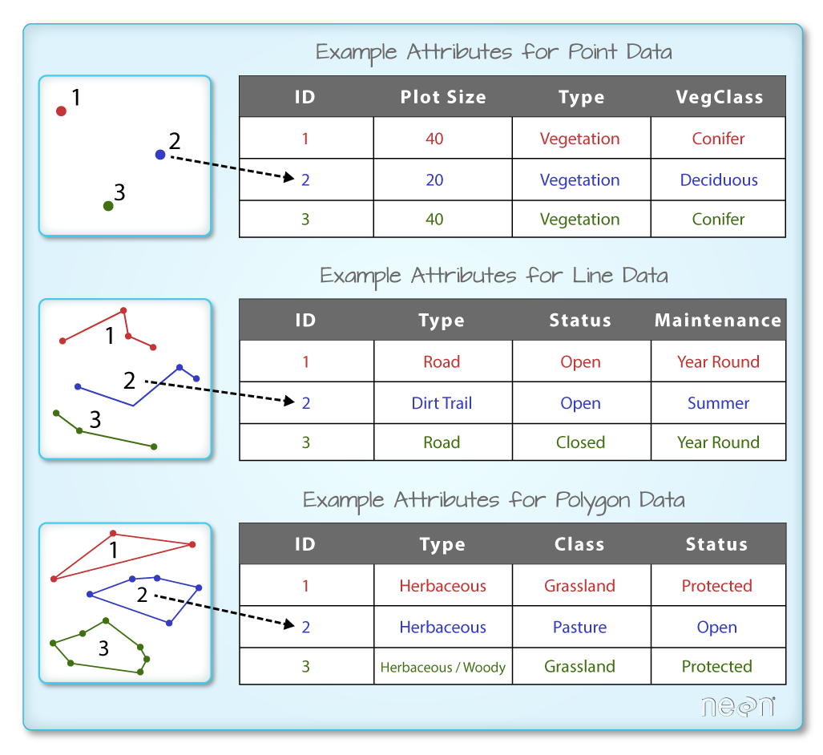
What is in the “DATA” part?
SpatialPointsDataFrame
Each point is a row
Layer
SpatialLinesDataFrame
Each line is a row
Stack
or
Brick
SpatialPolygonsDataFrame
Each Polygon is a row

Slide 20
So far so good?
Any questions?
Ready to continue?

Slide 21
What's on top of what?
One of the most basic questions asked of a GIS?
This questions are answered with the use of overlay tools that based on the overlap of multiple feature classes can:
Base operations
Erase
Intersect
Union
Derived operations
Identify
Difference

Slide 22
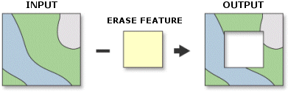
Erase
Creates a feature class by overlaying the Input Features with the polygons of the Erase Features.
Only those portions of the input features falling outside the erase features outside boundaries are copied to the output feature class.
raster::erase(Input, Erase feature)

Slide 23
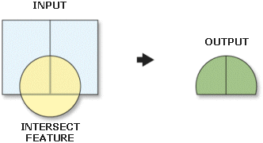
Intersect
Computes a geometric intersection of the input features.
Features or portions of features which overlap in all layers and/or feature classes will be written to the output feature class.
raster::intersect(Input, identity feature)

Slide 24
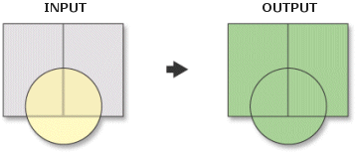
Union
Computes a geometric union of the input features. All features and their attributes will be written to the output feature class.
raster::union(Input-1, Input-1)

Slide 25
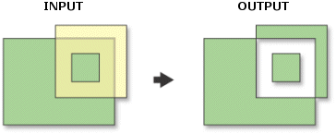
Difference
Features or portions of features in the input and update features that do not overlap will be written to the output feature class.
In R this requires a combination of erase and union functions
Step.1 erase yellow from green.
Step.2 erase green from yellow.
Step.3 Union the results of Sept 1 and Step 2

Slide 26
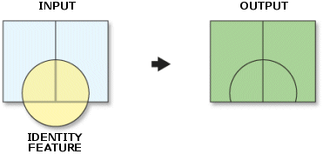
Identity
Computes a geometric intersection of the input features and identity features.
The input features or portions thereof that overlap identity features will get the attributes of those identity features.
In R this requires a combination of erase and union functions
Step.1 erase green from yellow.
Step.2 erase step 1 from yellow.
Step.3 Union the results of Sept 2 and blue

Slide 27
So far so good?
Any questions?
Ready to continue?

Slide 28
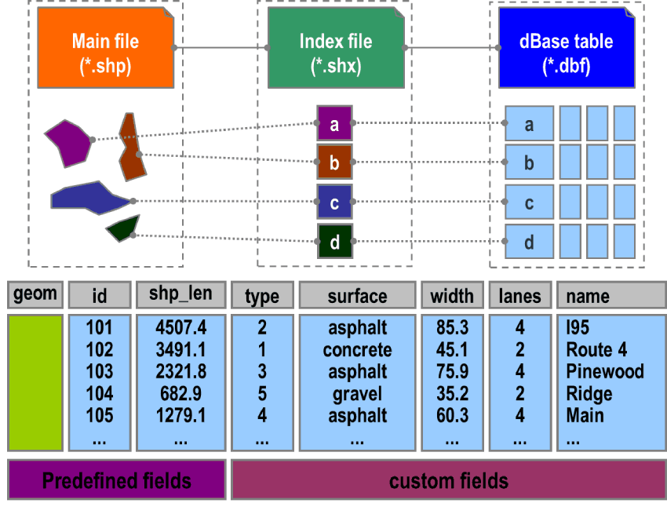
GIS Vector files
A format that is commonly used for exchanging vector data is the ESRI shapefile – represented by three files
Main file of geometries.
Index file to the geometries.
dBase storing attribute data.
You always need the three files!

Slide 29

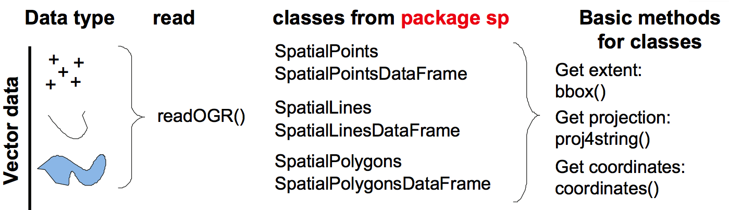
Load GIS Vector files in R
All vector loading functions in R depend on the Geospatial Data Abstraction Library (GDAL).
You will be able to open and save almost all existing geospatial formats!
But, you need to have the rgdal library installed.

Slide 30
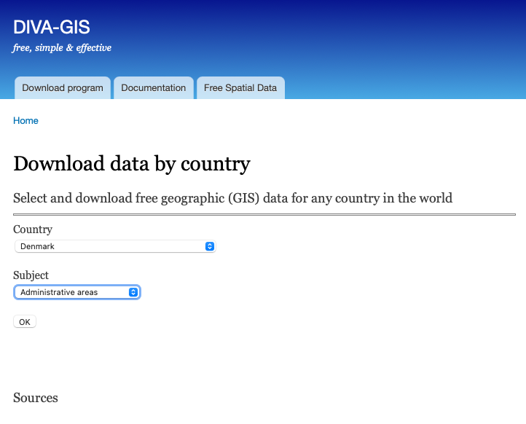
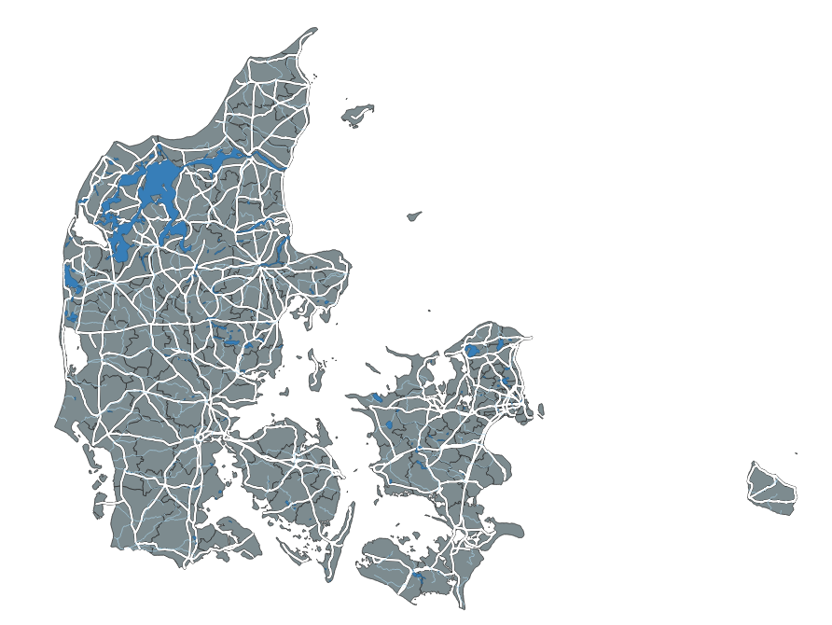
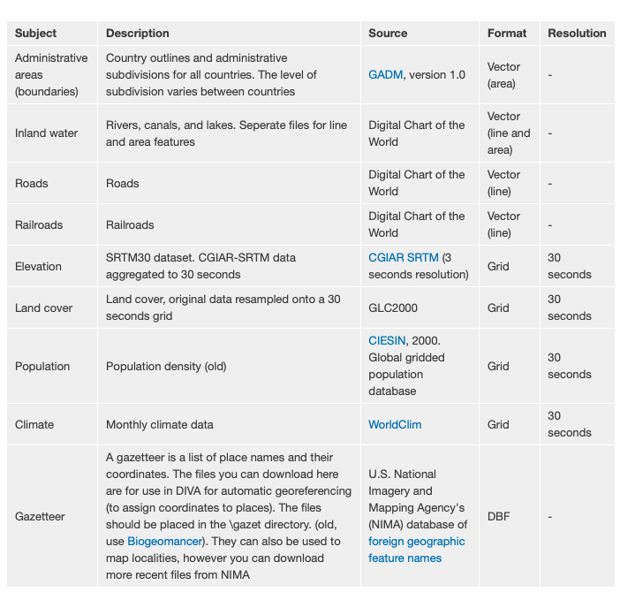
Where I can find Shapefiles Base cartography
https://bit.ly/2H9ZZ9d

Slide 31
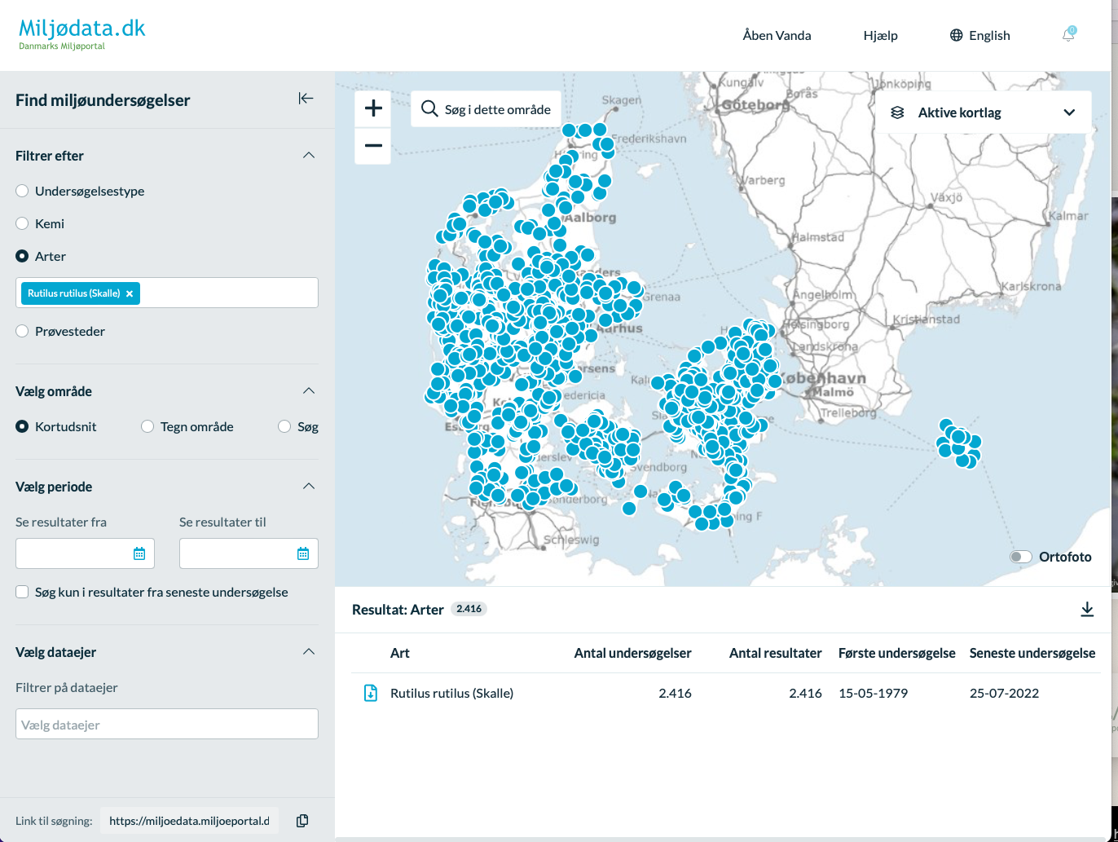

Where I can find Shapefiles Biological Data
https://miljoeportal.dk
Mian data source for Danish biological Data.
1. Specify the
species
2. Download the records

Slide 32
So far so good?
Any questions?
Ready to continue?

Slide 33
Spatial Objects in R
Raster
Vector
SpatialPointsDataFrame
Layer
SpatialLinesDataFrame
Stack
or
Brick
SpatialPolygonsDataFrame

Slide 34
What is raster data?
Matrix of cells (or pixels) organized into rows and columns (or a grid) where each cell contains a value representing information.
The information in these could be:
Thematic data represents features such as land-use or soils data.
Continuous data represents phenomena such as temperature, elevation, or spectral data such as satellite images and aerial photographs.
Pictures include scanned maps or drawings and building photographs.
Wave length
Red, green, or blue saturation
A numeric value

Slide 35
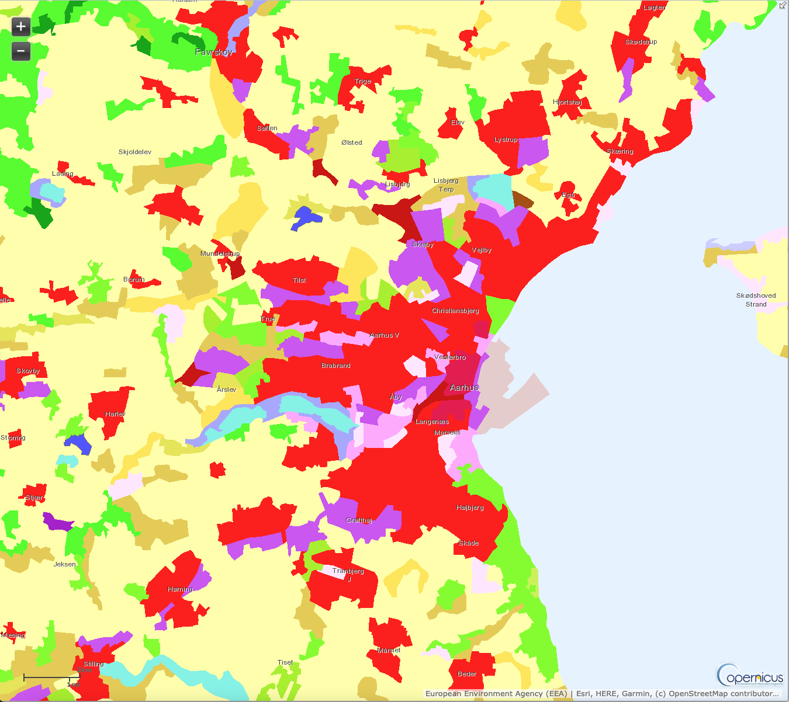
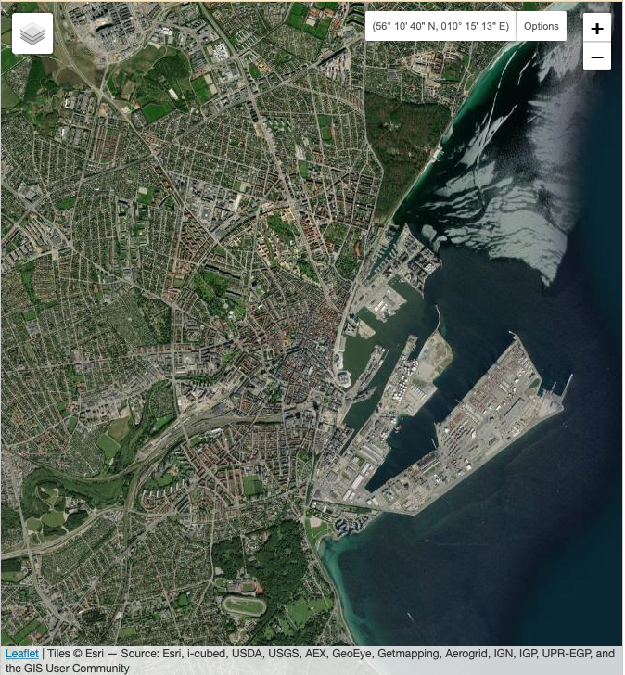
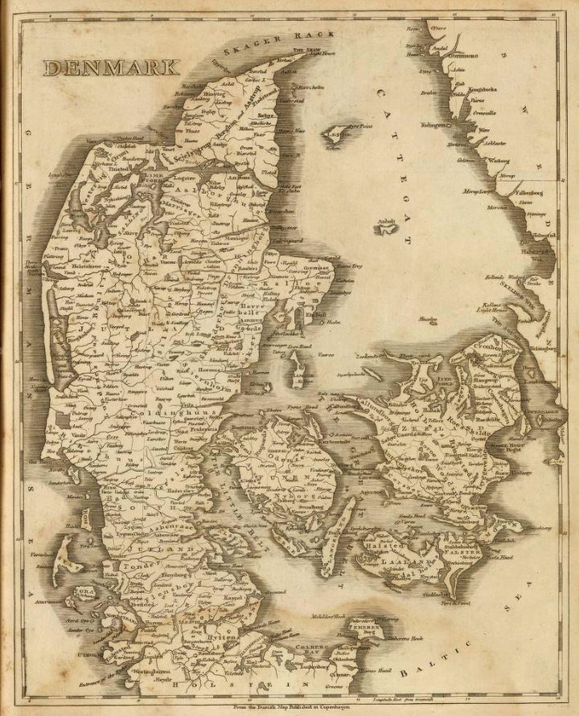
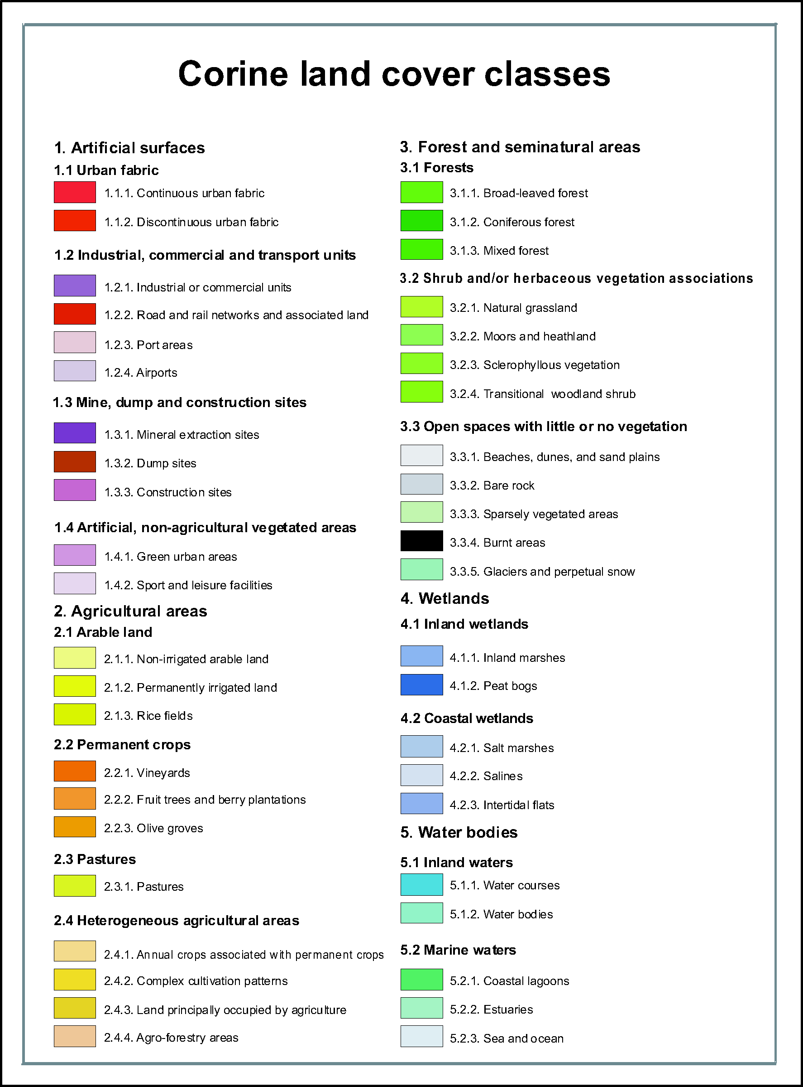
What is raster data?
Thematic data
Continuous data
Pictures
Land cover classification
Satellite image
Scanned map

Slide 36
Load Raster Object types In R
SpatialGridDataFrame
Raster Layer
Loaded with rgdal::readGDAL
Loaded with raster::raster

Slide 37
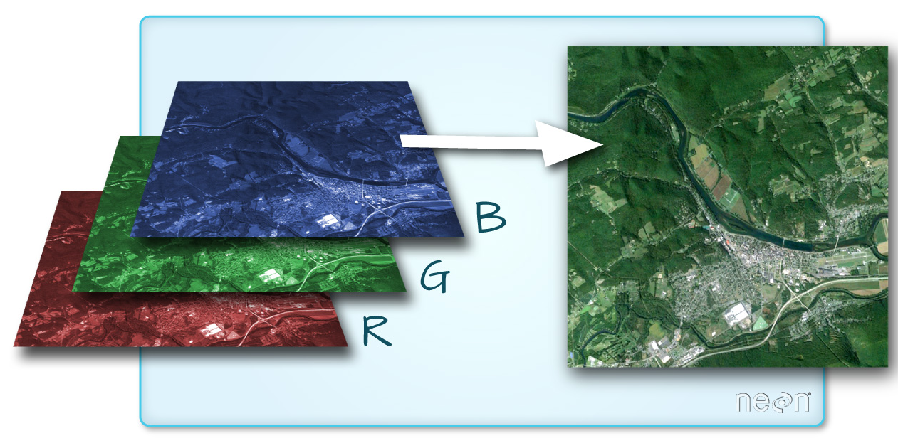
Single band and multiband Raster
A raster can contain one or more bands:
A typical example is a colour image that consists of three bands: red, green, and blue.
Based on how you combine these you can get true or false colour images

Slide 38
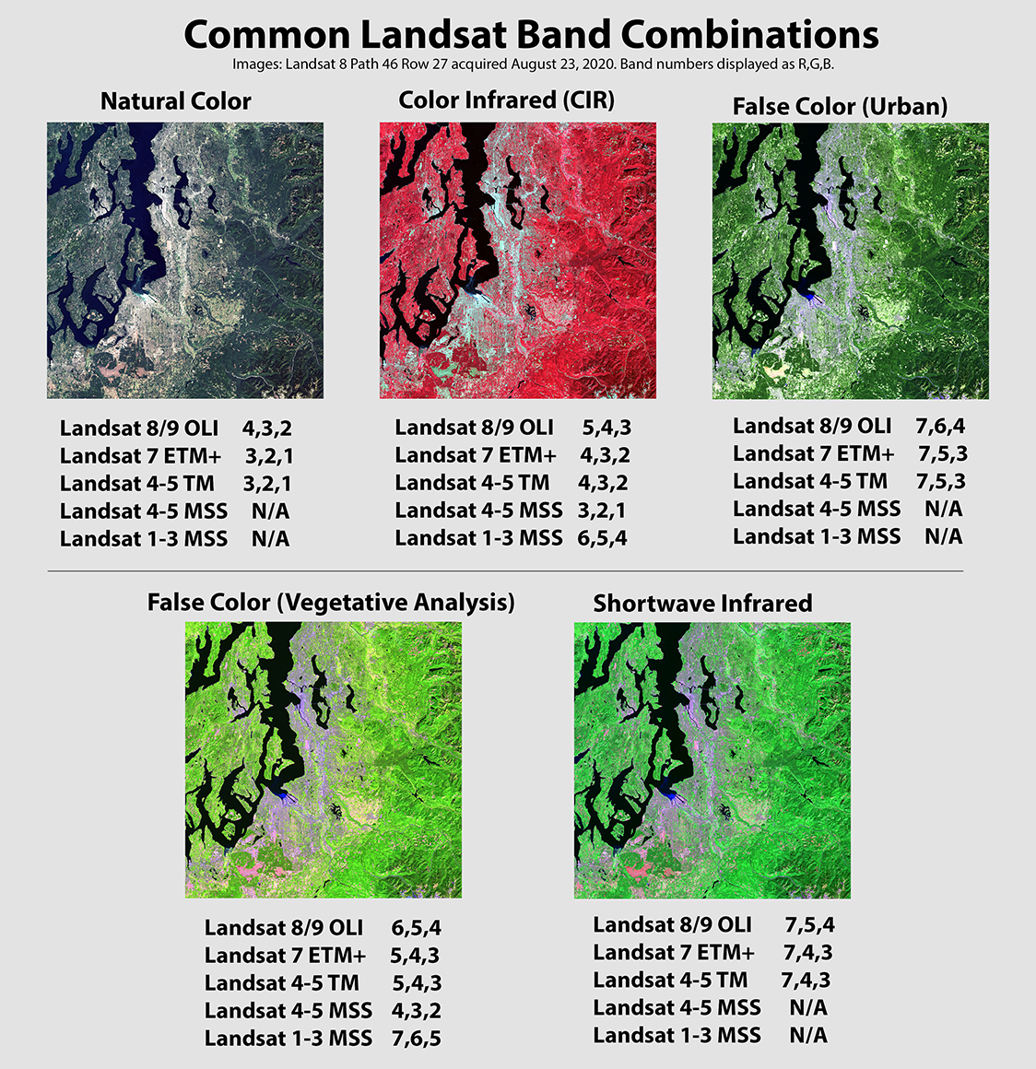
Multiband Representations
Based on how you combine multiple bands you can get different visualizations.
This is typically the case with satellite information that has many bands:
e.g., Landsat-8 has 11 bands
raster::plorRGB(Raster, BAND1, BAND2, BAND3)

Slide 39
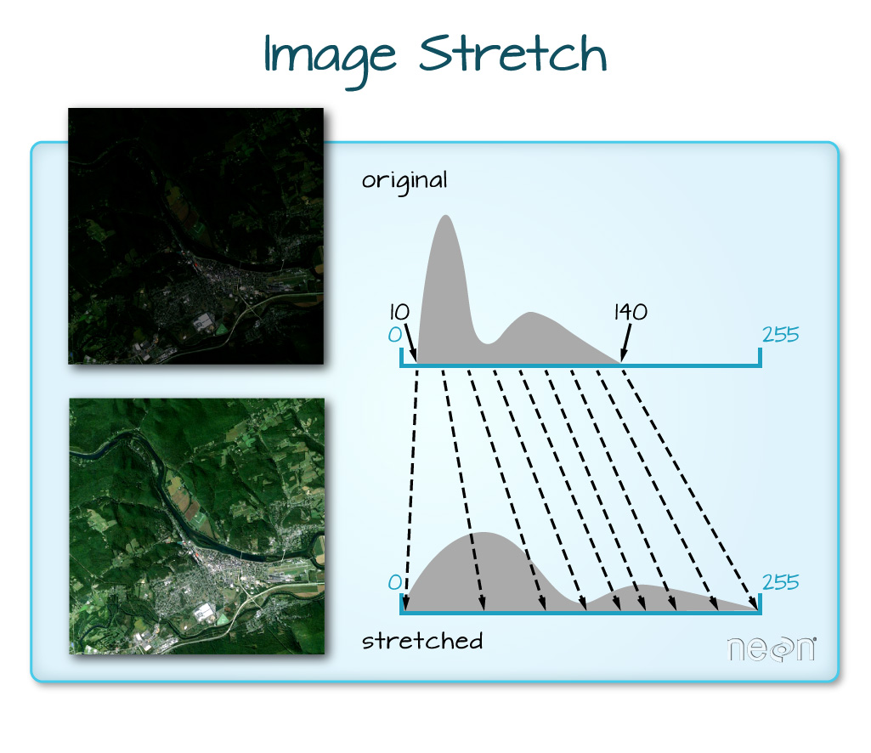
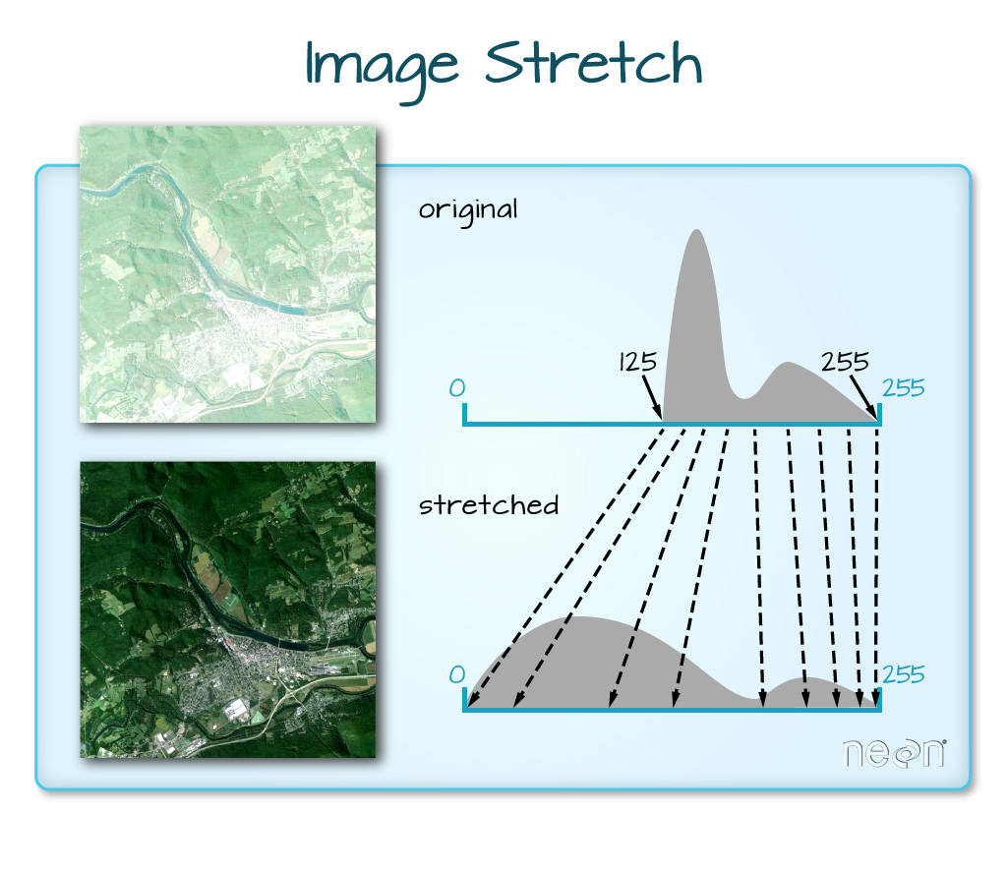
Stretching
Stretching the values in a raster can enhances an image by changing properties such as brightness, contrast, and gamma through multiple stretch types.
Darken oversaturated images
Brighten dark images

Slide 40
So far so good?
Any questions?
Ready to continue?

Slide 41
Cell-level functions on rasters
Although Raster data can be thought of as a matrix when doing operations it is treated as a vector where the cell number defines the position.
Cells are numbered continuously from top left to bottom right.
1 | 2 | 3 | 4 | 5
6 | 7 | 8 | 9 | 10
11 | 12 | 13 | 14 | 15
16 | 17 | 18 | 19 | 20
21 | 22 | 23 | 24 | 25
Basic transformations of a raster would be operations on a very long vector.

Slide 42
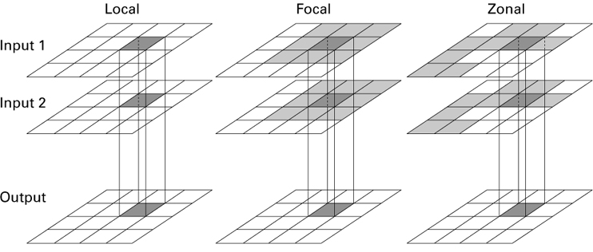
Map algebra

Slide 43
Local operations
Basic operations will be element by element
The same operation is done to each cell.
Calculations are based on overlapping.
 |  | 2
 |  | 3
 |  | 5
Input raster 1
Input raster 2
Output raster

Slide 44
focal statistics
Summarizes all the input cells that are in a specified neighbourhood.
Neighbourhoods can have different sizes n X/Y directions
 |  |  | 0 | 3 | 2
 |  |  | 3 | 5 | 4
 |  |  | 2 | 1 | 4
 |  |  |  | 24
Focal statistic → sum
0 + 3 + 2 +
3 + 5 + 4 +
2 + 1 + 4
= 24
Input processing raster
Output raster

Slide 45
Zonal statistics
A single output value is computed for every zone in the input zone dataset.
A zone is all the cells in a raster that have the same value, whether or not they are contiguous.
1 | 1 | 0 | 0
 | 1 | 2 | 2
4 | 0 | 0 | 2
4 | 0 | 1 | 1
0 | 1 | 1 | 0
3 | 3 | 1 | 2
 | 0 | 0 | 2
3 | 2 | 1 | 0
3 | 3 | 2 | 2
 | 3 | 2 | 2
3 | 2 | 2 | 2
3 | 2 | 3 | 3
Zonal statistic → max
Zone raster
Values raster
Output raster

Slide 46
So far so good?
Any questions?
Ready to continue?

Slide 47

Raster format Types
GRD
ASC
TIF
NC
BILL
IMG
Native' raster package format
ESRI Ascii
GeoTiff requires rgdal
netCDF requires ncdf4
ESRI native raster format
Erdas Imagine Images
All these can be loaded using either rgdal (readGDAL) or raster (raster) functions

Slide 48
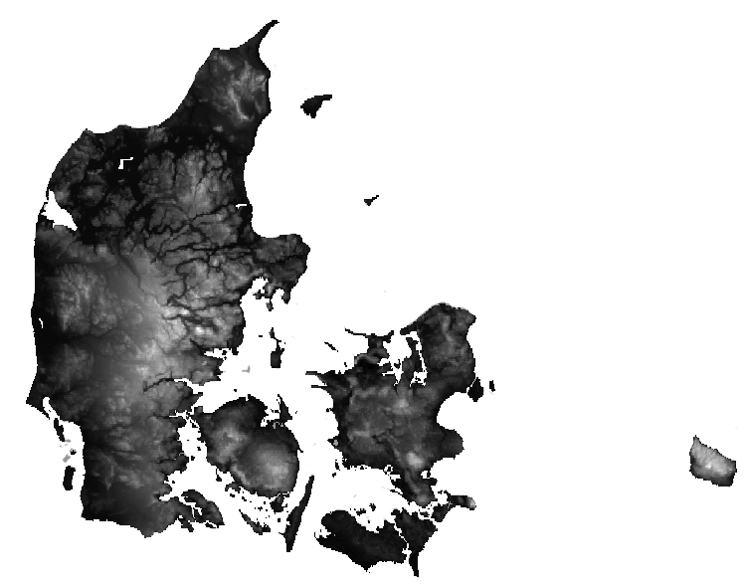
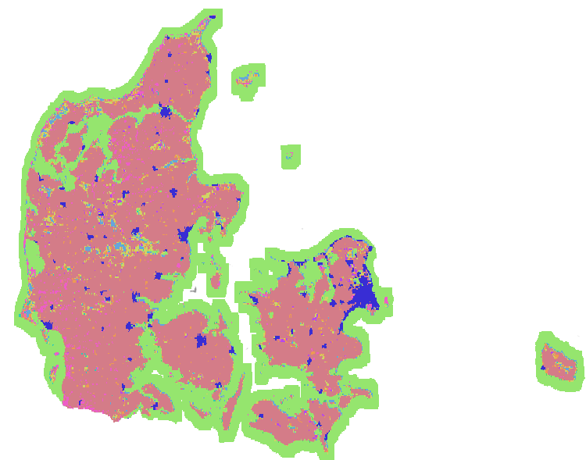
Where I can find Raster DATA Base rasters
Elevation
Land cover
https://bit.ly/2H9ZZ9d

Slide 49
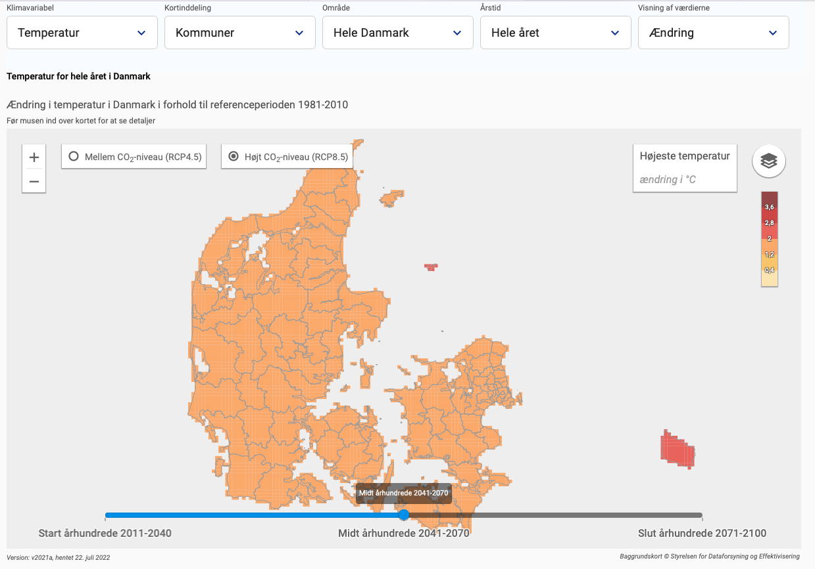
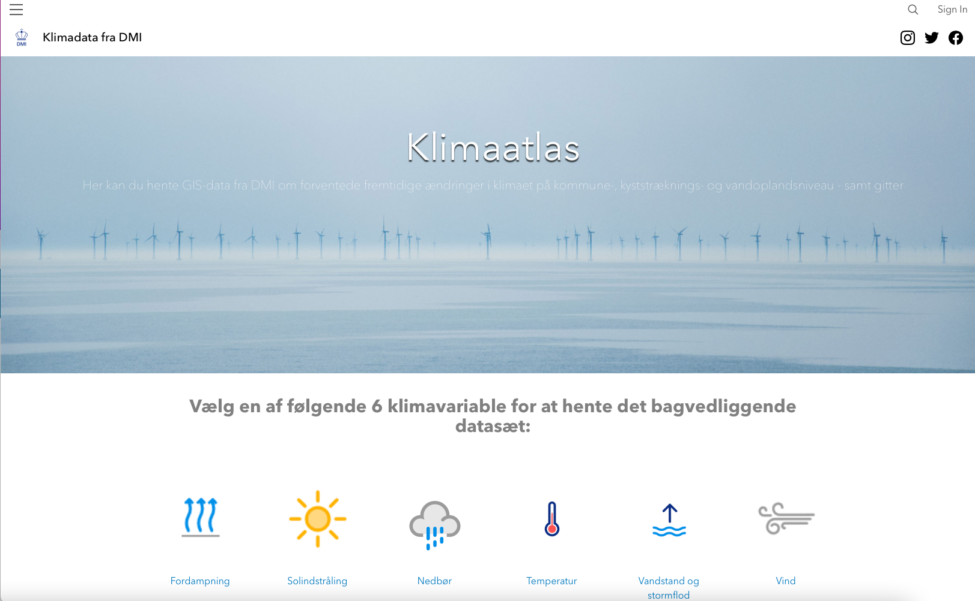
Where I can find Raster DATA Climate Variables
There is a web portal to visualize the data
https://bit.ly/3z1teF7
https://klimaatlas-dmidata.opendata.arcgis.com

Slide 50
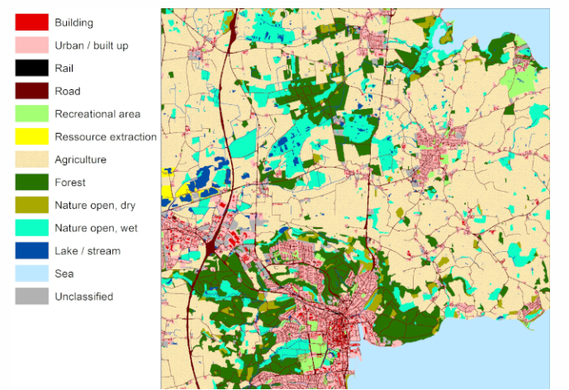
Where I can find Raster DATA Land cover
BASEMAP
[Land use 1990 – 2017]
National map of land use and land cover for Denmark at a 10x10 meter resolution
Land use maps for 2005, 2011 and 2017 are ready!
https://bit.ly/3BAXERJ

Slide 51
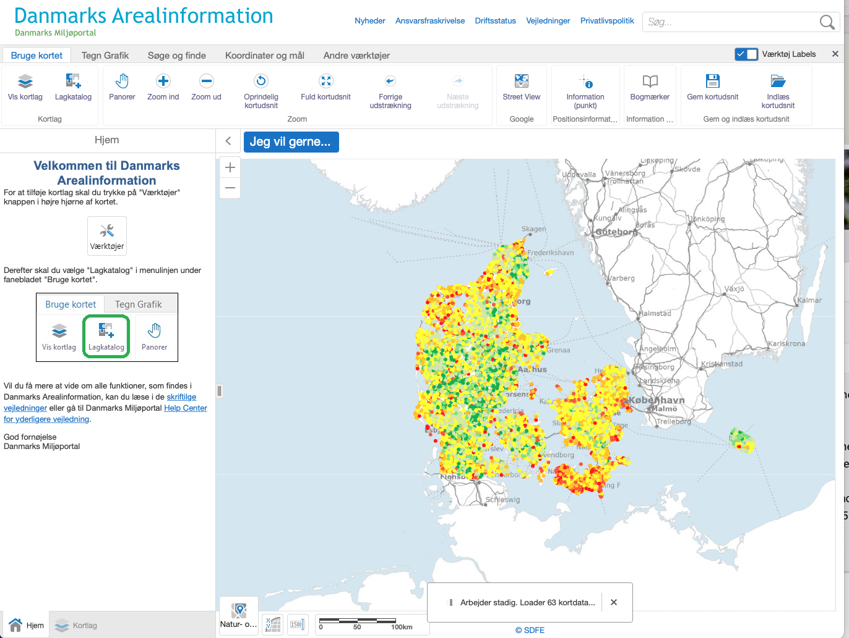
Where I can find Raster DATA Specific Environmental data
https://miljoeportal.dk
Mian data source for Danish biological Data.
1. Define the variable to plot
2. Get a URL to the Map

Slide 52
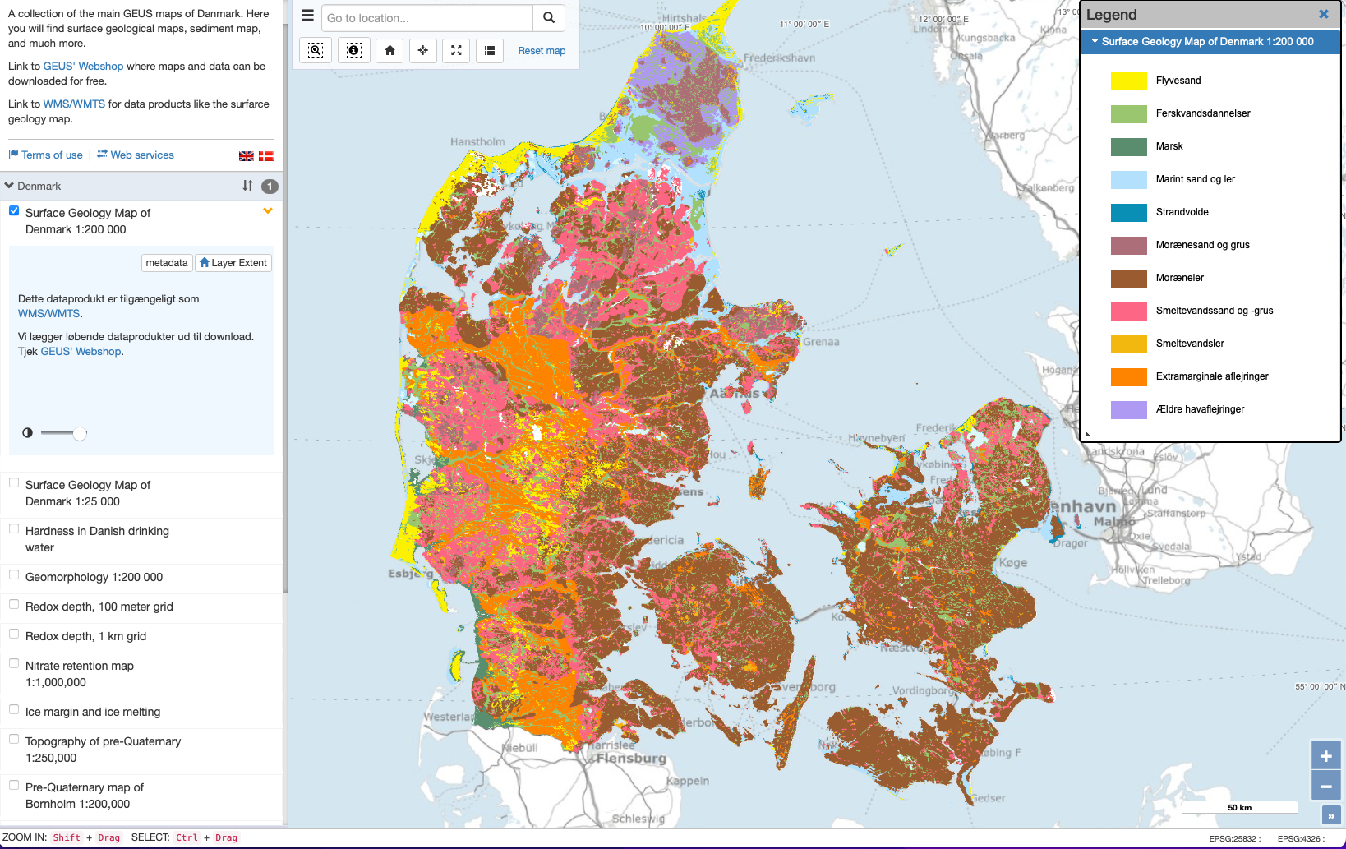

Where I can find Raster DATA Soils and geological attributes
https://bit.ly/3QflTJk
Here you find a collection of online maps of Denmark.

Slide 53
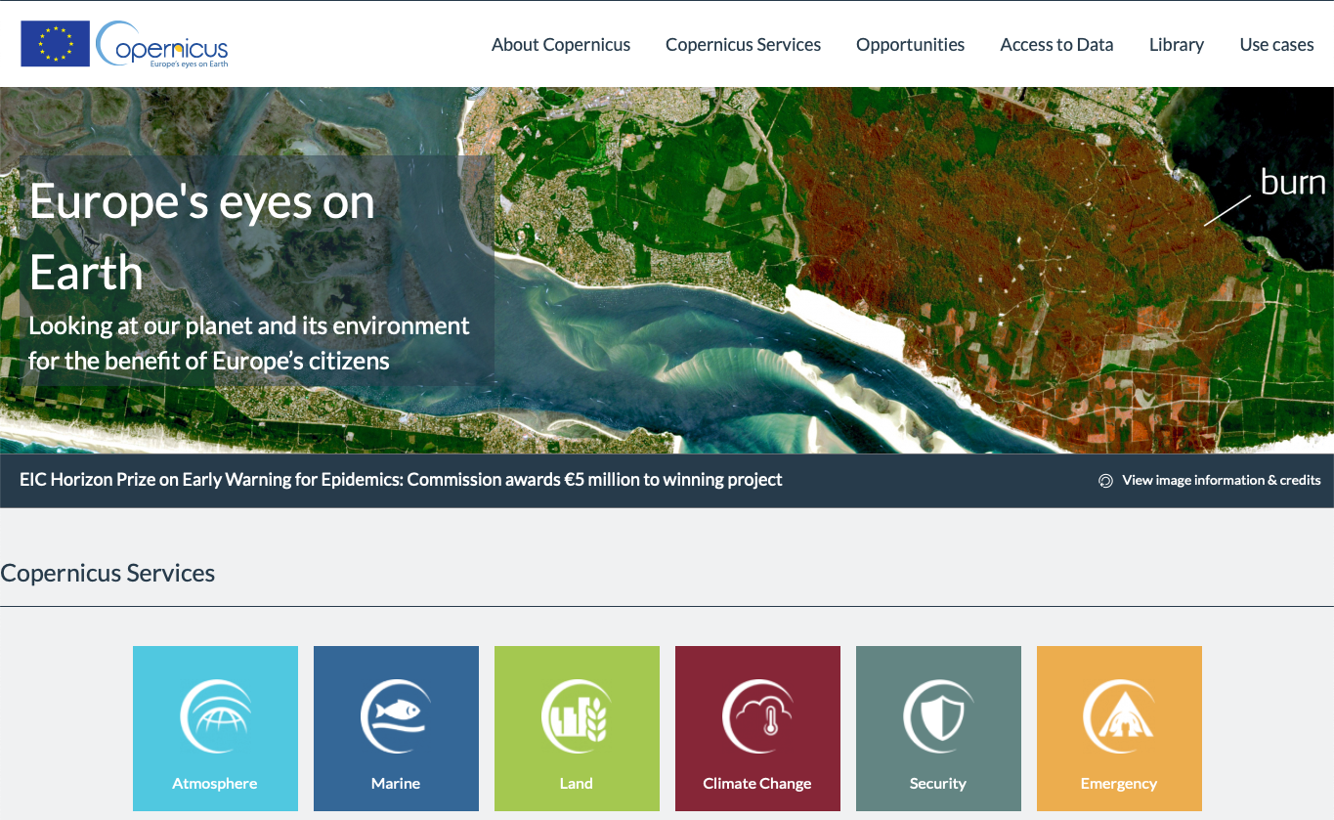

Where I can find Raster DATA High resolution for europe
The most comprehensive source of baseline and high resolution spatial data for Europe
There are different Monitoring Services
The most mature is the
Land Monitoring Service

